Slide 1

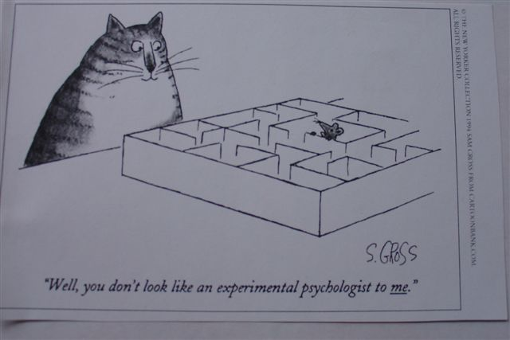
Rehabilitation of children with visual impairments
Work to be done!
Drs. Marjolein Dik
childpsychologist / neuropsychologist
Royal Dutch Visio, Amsterdam

Slide 2
Work to be done!
1. Lebers Congenital Amaurosis
2. Developmental setback and autism
3. Coloboma
4. CVI
5. Prematurely born children
6. Visual-motor system/Attention
7. ?

Slide 3
Lebers Congenital Amaurosis
Early onset of TRD
So far more than 18 genes have been found
Developmentally very interesting group
Urgent! Gene / gene combination for phenotype subgroups in order two inform parents from the start on what is ahead of them.

Slide 4
Features
Early visual reactions to movement/patterns – disappearing/some colour
Some high hyperopia – no effect of glasses
Eye poking, deep eye pockets
Facial comparable? Forehead
Hypermobility; low muscle tone
Over/under registration problems (SI)
Cognitive fit
Social emotional less fast
Breaking point 15-18 months
Split in 2 main developmental groups
Parents
Musically gifted

Slide 5
Features
Early visual reactions to movement/patterns – disappearing/some colour
Some high hyperopia – no effect of glasses
Eye poking, deep eye pockets
Facial comparable? Forehead
Hypermobility; low muscle tone
Over/under registration problems (SI)
Cognitive fit
Social emotional less fast
Breaking point 15-18 months
Split in 2 main developmental pheno groups
Parents
Musically gifted

Slide 6
Developmental setback, TOM, Autism
1/3 of children with autism shows developmental setback – much more in blind children
In normal population: incidence ASD 0,6-1%
About twice as often in blind children
Autism as a consequence of blindness itself?
No!
Neural programming – Parietal development?
Cilio pathy or other cell metabolism programming?
Hobson, R. P., & Bishop, M. (2003). The pathogenesis of autism: Insights from congenital blindness. Philosophical Transactions of the Royal Society of London: Series B: Biological Sciences, 358, 335– 344.
Hobson, R. P., Lee, A., & Brown, R. (1999). Autism and congenital blindness. Journal of Autism and Developmental Disorders, 29, 45–56.

Slide 7
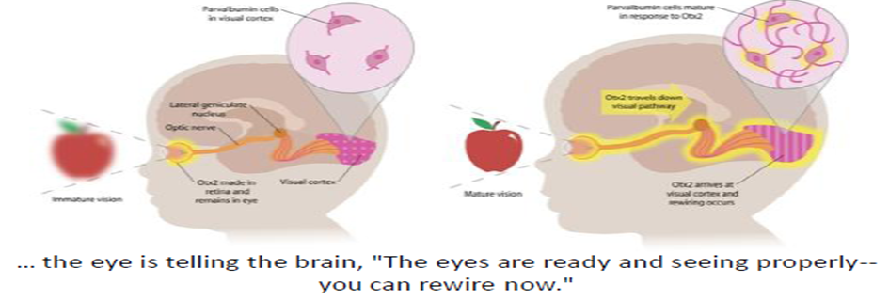
Sugiyama S, Di Nardo AA, Aizawa S, Matsuo I, Volovitch M, Prochiantz A, Hensch TK. (2008) Experience- dependent transfer of Otx2 homeoprotein into the visual cortex activates postnatal plasticity. Cell 134:508-520.
Morishita H, Hensch TK. (2008) Critical period revisited: impact on vision. Curr Opin Neurobiol. 18: 101-107.
Waugh, M.C., Chong, W.K., Sonksen, P.M. (1998) Neuroimaging in children with congenital disorders of the peripheral visual system . Developmental Medicine and Child neurology, 40, 812 – 819
Sonksen,P.M., Dale, N. (2002). Visual impairment in infancy: impact on neurodevelopmental and neurobiological processes. Developmental Medicine & Child Neurology 2002, 44: 782–791
Begeer, S.; Dik, M,; voor de Wind, M.J.; Asbrock, D.; Brambring, M.; Kef, S. (2014). A New Look at Theory of Mind in Children With Ocular and Ocular-Plus Congenital Blindness. Journal of Visual Impairment & Blindness. Jan/Feb2014, Vol. 108 Issue 1, p17-27. 11p. 1 Chart. (9-22 children)
Developmental setback in children with congenital blindness, Literature review and record analysis
Ans van Eijden, Ellen van den Broek Royal Dutch Visio, The Netherlands
(work in progress)

Slide 8
To be done
Search together!
Collect all gene information at one /two points Who/where?? London?
Ask the grown ups LCA to participate (11 of 45)
Prospective research- describe development the same way, measure at the same time and with the same instruments in order to offer the right intervention
Parents need to know what is ahead of them!

Slide 9
coloboma
Relatively stable but …..
.
No neurological problems
ERG normal, 1 VEP indicated a bit higher acuity
Suspect for aggravation, psychogenic loss?
No! Professional feels helpless. Is this something specific? Do you recognise it?
Who wants to collect?
child | diagnosis | iris | retina | macula | papil | Visus early | later | later
F 98 | Micropth complex | x | x | x |  | 0,06 | 0,12 | 0,16
F 97 | idem | x | x | x | x | 0,8/ 1.- | 0,75/0,25 | 0,12/0,3
F 98 | micropth |  | x |  |  | 0,25 | 0,12 | 0,05

Slide 10
Cerebral visual impairment
CVI

Slide 11
ICF functional discrepancy model: 5 steps to get to CVI
1.Ophthalmologist/optometrist diagnoses
b210 Seeing functions Sensory functions visual acuity functions; visual field functions; quality of vision; functions of sensing light and colour, visual acuity of distant and near vision, monocular and binocular vision; etc.
b215 Functions of structures adjoining the eye (movement aspect)
Team: Can activity and participation problems be explained by developmental level and these data?
Yes: standard approach for sensory impairments
2. No:
Neuropsychologist chooses testmaterial taking into account all available diagnoses - also brainstruccture information (s110) from neurologist - to formulate hypotheses
3. Find information about, measure and compare the following functions:
b110 consciousness/b130 energy and drive functions
b117 (verbal) Intellectual functions
b122 Global psychosocial functions
b7.. Movement related functions
b144 non visual memory functions
b140 non visual attentional functions
B164 executive (higher cognitive) functions
=
b1561 visual perception
b1565 visuo-spatial perception
B144 visual memory
b140 visual attention
b760 visual-motor integration

 
4. Team: Validate each visual problem: mild, moderate, severe, complete impairment
5. Team: Help is indicated by one complete/ severe, ? moderate and ? mild
(taking other diagnoses into account as well)

Slide 12
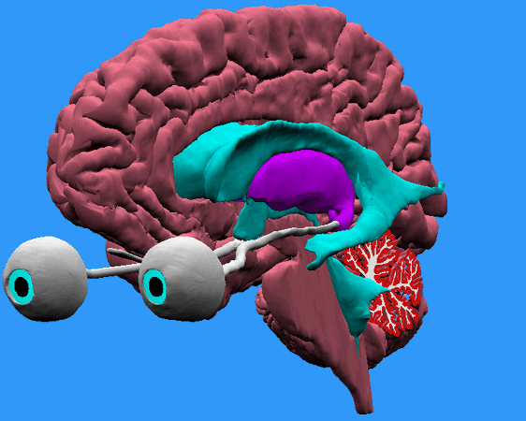
Issues
Features ↔Functions
Questionnaires ↔Tests with age norms
Excluding executive functioning ! (“just” posterior attention= selective and directing/orienting)
Changes over time/development/age
Co-morbidity; along with other health problems

Slide 13
How about age and co-morbidity ?
age | diagnosis | acuity | Fld | SIP ☺ | M0 | VIQ | ☺ ear | ☻ Lat | Rec ear | DTVP2 FC FB | Vis Mry | Spa Ori | Speed up | Attent S O P | Ps So | Pho LM
♂95 | ROP/PVLI(lFr) | 0,25 →0,7 | ☼ | - | + | 93/80 | + | + | + | 10 7 | + | ±RF7 | ++ | - + + | + | -
♂98 | ROP+ hydroc | 0,08 | ☼ | + + | + | 98 | - | - | - | 6 11 VPOR 11of 30 | ++ | ± | ++ | + + - | - | +
♀98 | ↓ braintss ci | <0,1 → 0.6 | ± | - - | ± | 110 | - | + | - | 8 8 | 8 | ± | ± | - + + | + | +
♂99 | asphyxia | 0,6A 0,4 L | ☼ | - | + | 82 | + | + | + | 9 7 | 9 | + | + | - - + | ± | -
♂00 | Hydroc 3x | 0,1 | ☼ | - | - | 92 | + | + | - | +(7) 7 | + | ± | - | - + + | + | +
♂01 | car arr/PrOc/CP | 0.25 | ↓HF | - - | - | 79 | - | + | - | 7 8 | 9, 8 | ±RF6 | - | - + ± | ± | -dp
♂01 | ROP/prem | 0,6A/0,4L/0,2N | R↓ | - + | + | 101 | + | + | + | 11 13 | ++ | + | + | - - + | + | -
♂02 | ROP prem (at 4) | 0,1 → 0.5A 0.25L | + | - | ± | 103 | ? | + | ? | 10 11 | + | + | - | - - - | - | +
♂03 | Catar/metabl | 0,2L/0,25A | + | - - | ± | 88 | - | + | - | 11 11 | + | + | ± | - + + | + | -dp
♀05 | Heamorr hypoglycem | 0,25/0,2 | L + | - | - | 91 | - | + | - | 10 10 | + | + | - | - - - | + | -dp

Slide 14
In our rehabilitation practice (a selected group)
About 40% of the children keeps the diagnosis CVI getting older (hydrocephalus!)
About 60% of the children (in our region!) shows more severe other functional problems (dyspraxia, dyslexia, severe coordination problems, ADHD) over time.
Early visual problems as a warning/marker of more to come
CVI in young children has to be followed into school age – about 50% (in our region!) shifts to another kind of help service.
Naming?
New challenge: Multi domain disabilities with relatively intact intelligence (complex learning disabilities ≠CVI )!

Slide 15
Pre mature birth and visual impairment
age | diagnosis | acuity | Fld | SIP ☺ | M0 | VIQ | ☺ ear | ☻ Lat | Rec ear | DTVP2 FC FB | Vis Mry | Spa Ori | Speed up | Attent S O P | Ps So | Pho LM
♂95 | ROP/PVL I (lFr) | 0,25 →0,7 | ☼ | - | + | 93/80 | + | + | + | 10 7 | + | ±RF7 | ++ | - + + | + | -
♂01 | ROP/prem | 0,6A/0,4L/0,2N | R↓ | - + | + | 101 | + | + | + | 11 13 | ++ | + | + | - - + | + | -
♂02 | ROP prem (at 4) | 0,1 → 0.5A 0.25L | + | - | ± | 103 | ? | + | ? | 10 11 | + | + | - | - - - | - | +

Slide 16
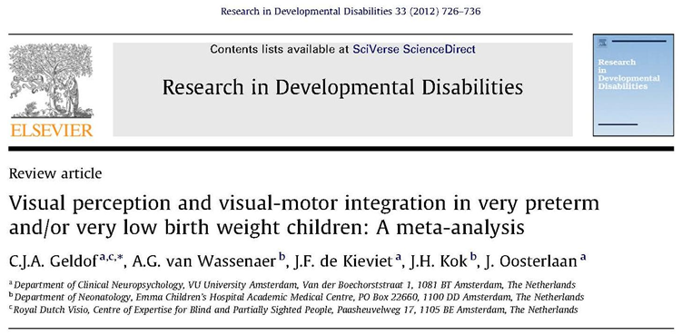
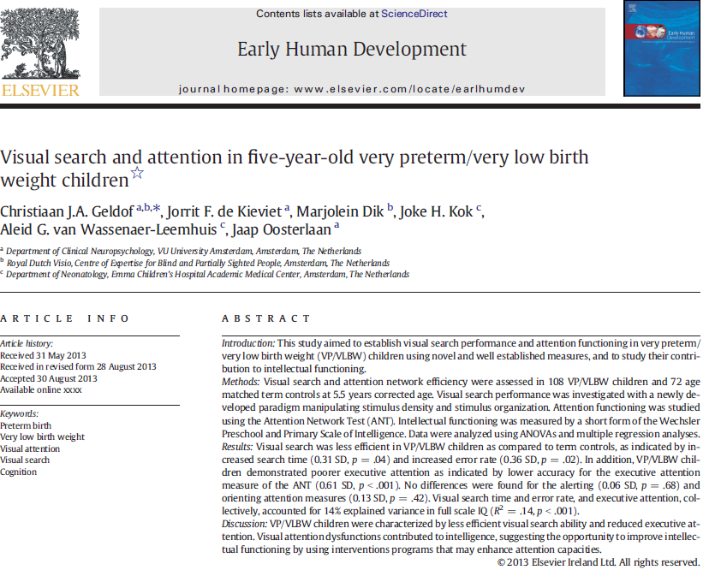
High Incidence of Multi-Domain Disabilities in Very Preterm Children at Five Years of Age
Eva S. Potharst, MsC, Aleid G. van Wassenaer, MD, PhD, Bregje A. Houtzager, PhD, Janeline W. P. van Hus, BHS,
Bob F. Last, PhD, and Joke H. Kok, MD, PhD
Objectives To describe the prevalence and co-occurrence of disabilities and their association with parental education in preterm children and term control subjects.
Study design In a prospective study, preterm children (n = 104), born at <30 weeks’ gestation or birth weight
<1000 g, and term children (n = 95) were assessed at corrected age 5 with an intelligence quotient (IQ) test, behavior questionnaires for parents and teachers, and motor and neurologic tests. A disability was defined as results in the mild abnormal range of each test or below. Associations of outcomes with parental education were studied.
Results Of the preterm children, 75% had at least one disability and 50% more than one, compared with
27% and 8%, respectively, of term control subjects (P < .01). The preterm-term difference in full scale IQ increased from 5 IQ points if parental education was high to 14 IQ points if it was low, favoring the term children in both groups. A similar pattern was found for behavior, but not for motor and neurologic outcome.
Conclusions Disabilities occur frequently after very preterm birth and tend to aggregate. Neurologic and motor outcomes are mostly influenced by biologic risk, and social risks contribute to cognitive and behavioral outcome. (J Pediatr 2011;159:79-85).

Slide 17
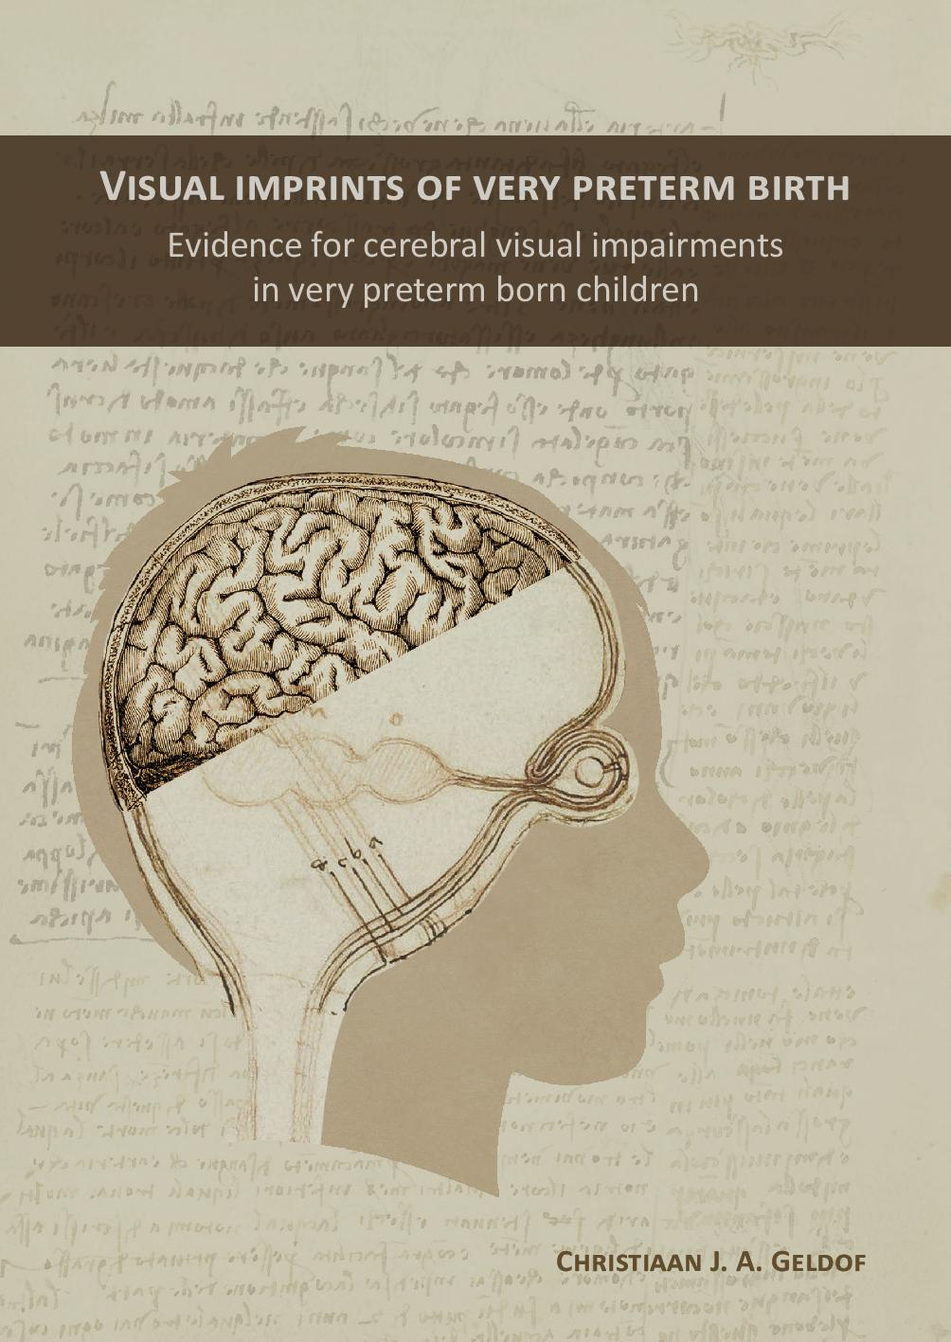
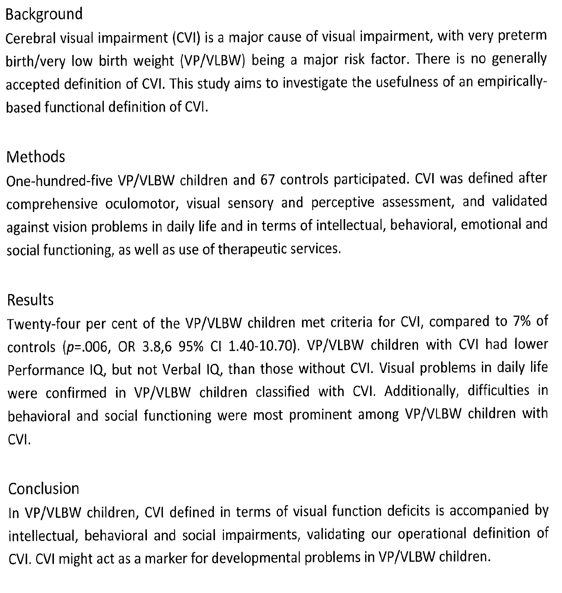
A functional approach to cerebral visual impairments in very preterm/very-low-birth-weight children
Christiaan J.A. Geldof1,2, Aleid G. van Wassenaer-Leemhuis3, Marjolein Dik2, Joke H. Kok3 and Jaap Oosterlaan1,4
Received 8 September 2014; accepted 19 January 2015; advance online publication 00 Month 2015. doi:10.1038/pr.2015.83 Copyright © 2015 International Pediatric Research Foundation, Inc.
Vaker visueel sensorische én perceptieve stoornissen
Vaker stoornissen in visueel zoeken en aandacht
CVI lijkt een indicator voor ontwikkelingsproblemen van ernstig vroeggeboren kinderen te zijn

Slide 18
8 year old boy (born at 27 wks)
Mean intelligence
Oversensitive for light, haptic underregistration, cann’t sit still
Gets too close to work for acuity 0,62 ODS, 0,4Lin 0,5 Ang, fixation problems (glasses -4)
Attention: finds enough targets, needs more time and fingers (normscore 7), “neglect” left sided underneath
Visual Perception; mean scores
VMI: Beery mean scores (on paper); action fails on right side (bumps into things at that side) also his balance is less developed

Slide 19
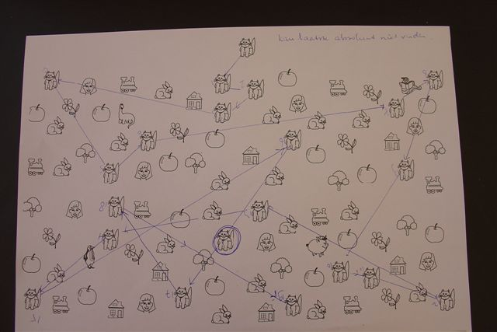
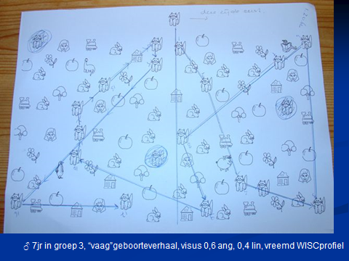
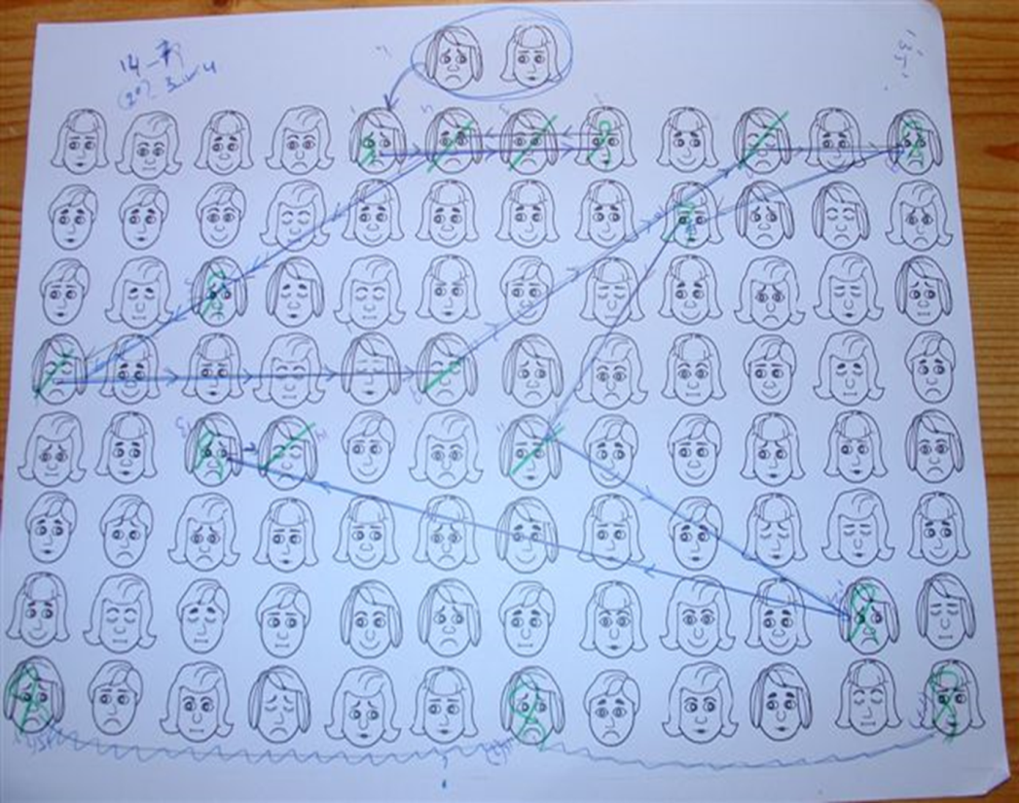
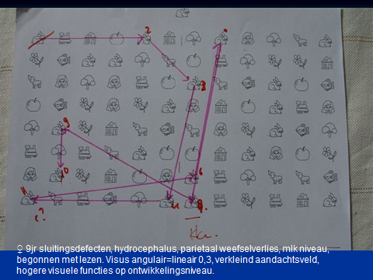

Slide 20
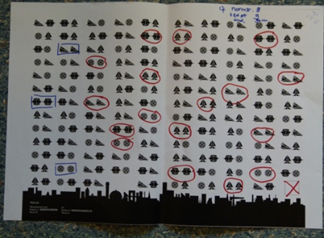
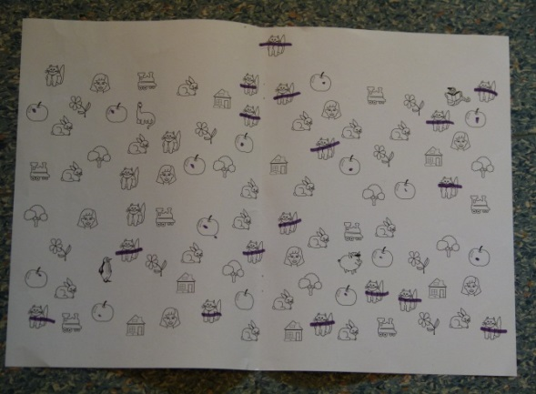

Sub test Space ships Tea-Ch
NEPSYI

Slide 21
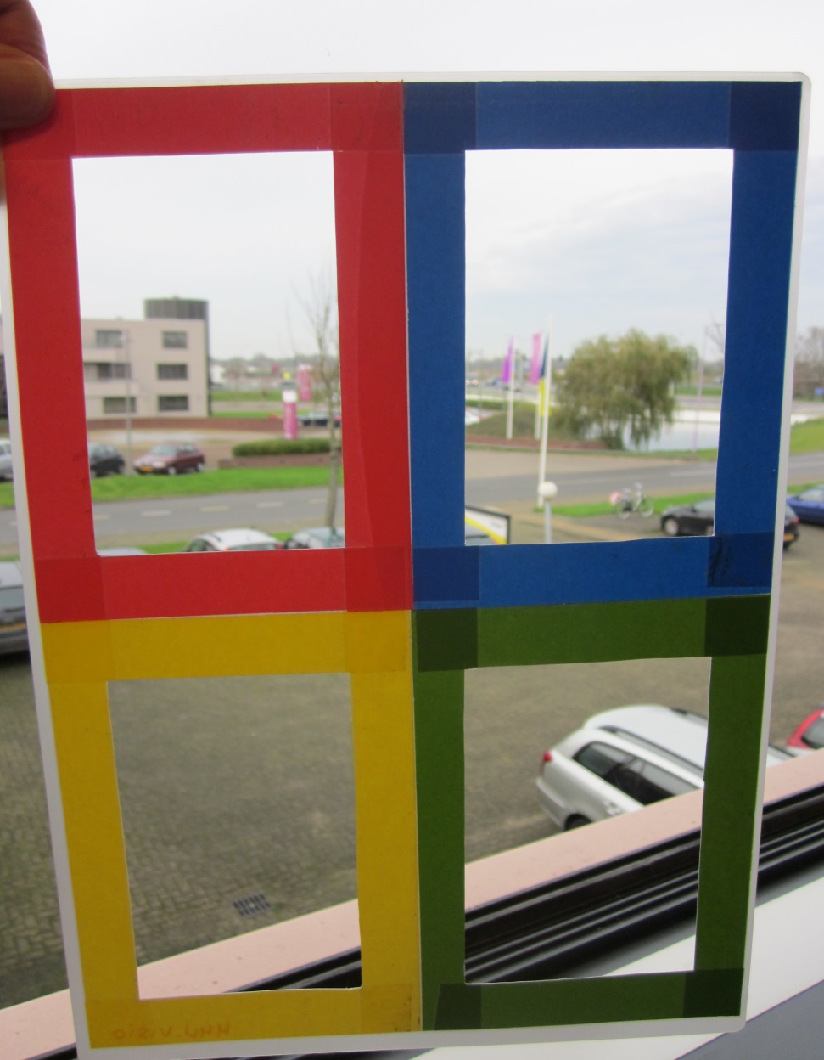
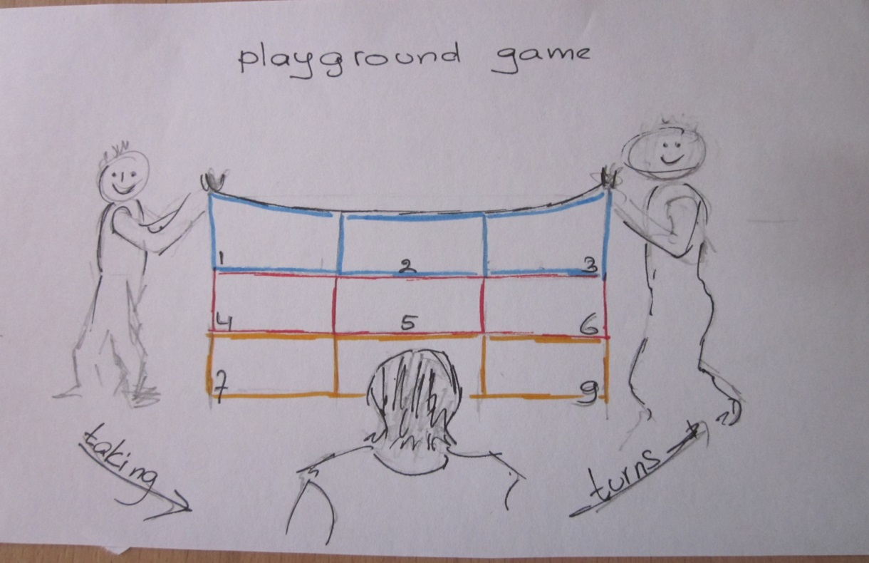
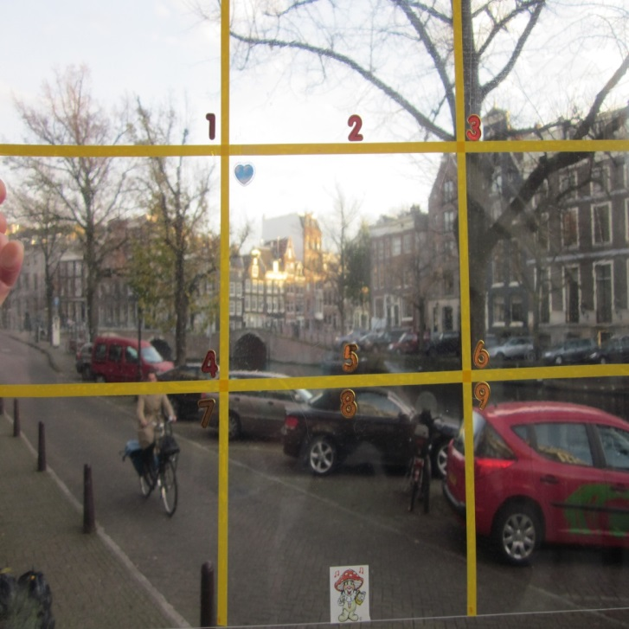
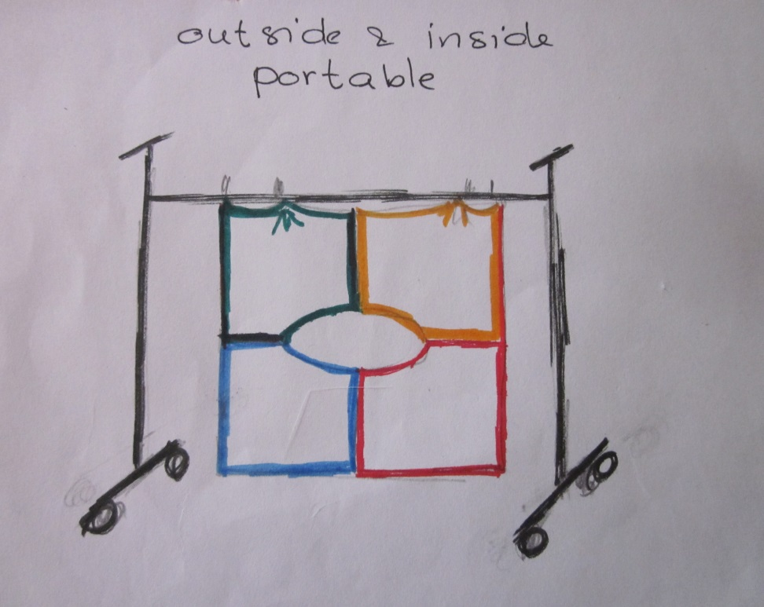
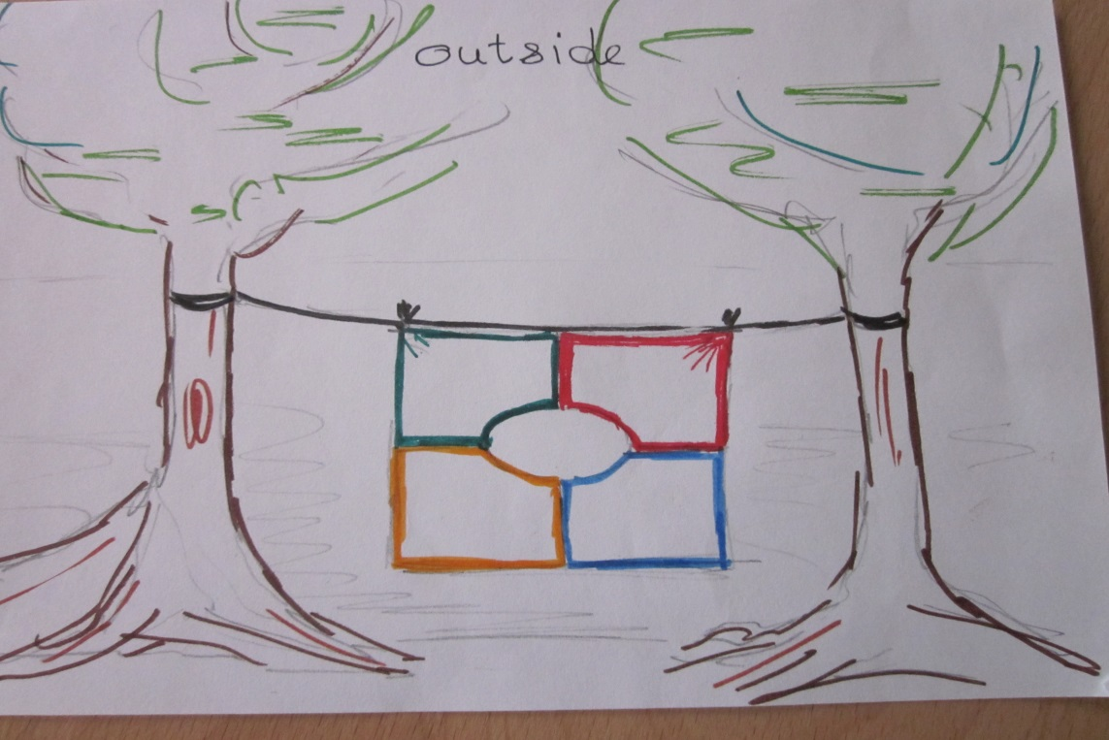

Slide 22
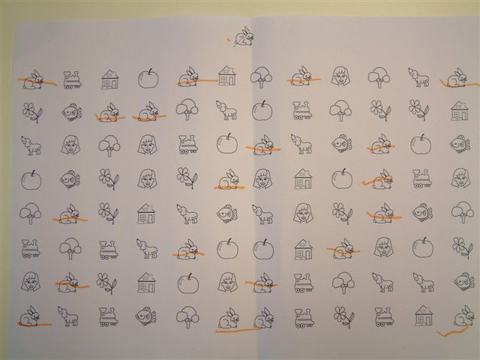
Ataxia & eye movements

Slide 23
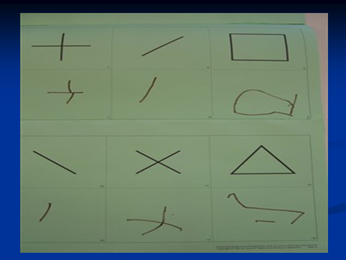
Visual- motor integration
Eye-hand and eye –foot coordination
Usually tested with Beery or DTVP2 – on paper while sitting still
How and what do we test in action with the whole body?

Slide 24
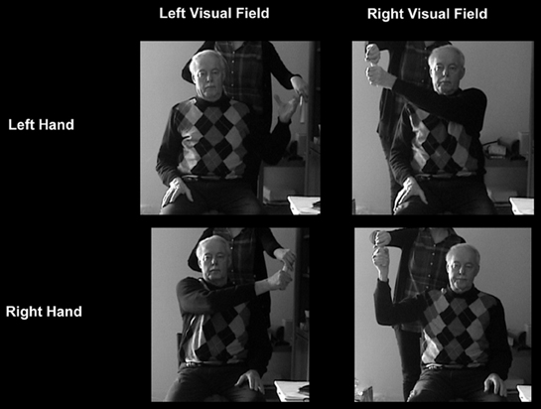
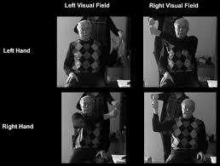
In action !
Front. Hum. Neurosci., 02 July 2013 | http://dx.doi.org/10.3389/fnhum.2013.00324
Guidelines and quality measures for the diagnosis of optic ataxia
Svenja Borchers¹, Laura Müller², Matthis Synofzik^{3,4} and Marc Himmelbach^{1,5}*
¹Division of Neuropsychology, Department of Cognitive Neurology, Centre for Neurology, Hertie-Institute for Clinical Brain Research, Eberhard Karls University, Tübingen, Germany.²Department of Psychiatry, Psychosomatics and Psychotherapy, University of Würzburg, Würzburg, Germany. ³Department of Neurodegenerative Diseases, Hertie-Institute for Clinical Brain Research, Eberhard Karls University, Tübingen, Germany
⁴German Research Center for Neurodegenerative Diseases (DZNE), Eberhard Karls University, Tübingen, Germany
⁵Centre for Integrative Neuroscience, Eberhard Karls University, Tübingen, Germany
Optic ataxia: misreaching for peripheral targets where as actions in central vision are spared
Rizzo & Vecera 2002
Anatomic base : Parietal occipital sulcus+junction (Prado 2005)
Christopher Striemer (2007) Overall decrease in the salience (orienting attention, disengaging) of stimuli in the ataxic field
Stephen Jackson (2007) an inability to construct and utilise intrinsic (limb based) motor codes when visual cues are available
White matter damage also unilateral lesions
Independent visual space perception, differences for left - right

Slide 25

Action VMI & attention
British Journal of Visual Impairment 2015, Vol. 33(1) 66– 73
© The Author(s) 2014
Reprints and permissions:
sagepub.co.uk/journalsPermissions.nav
DOI: 10.1177/0264619614553860
jvi.sagepub.com
BJVI
Some children with multiple disabilities and cerebral visual
impairment can engage when enclosed by a ‘tent’: Is this
due to Balint syndrome?
Suzanne Little
Meldreth Manor School, UK
Gordon N Dutton
Glasgow Caledonian University, UK
Abstract
This article describes and reflects upon the use of diffusely coloured tents to enclose both child and therapist which, in our service, has brought about remarkable transformations in attention, engagement, and understanding for severely impaired children with multiple disabilities and cerebral visual impairment (MDVI). A brief overview of how to construct this simple tent is presented, and the ways in which these tents have proved effective are described by means of two case studies of students with complex needs. The positive impact over a 2-year period was considerable. The changes brought about persisted into typical environments, and parents and carers expressed surprise and delight at the outcome. The proposed explanation is that the children who benefitted had profound impairment in seeing more than one or two items at once (simultanagnosia) due to presumed damage in the posterior parietal lobes of the brain, related to their cerebral palsy, and that elimination of distraction allowed this limited visual function to be recruited, to afford meaningful experience and enhance learning.

Slide 26
Neuropsychologia 44 (2006) 2734–2748 No double-dissociation between optic ataxia and visual agnosia:
Multiple sub-streams for multiple visuo-manual integrations
L. Pisella a,b, F. Binkofski c, K. Lasek c, I. Tonid,e, Y. Rossetti a,b,∗
a INSERM UMR-S 534, Institut National de la Sant´e et de la Recherche M´edicale, and Universit´e Claude Bernard-Lyon, Espace et Action, Bron, France
b ‘Mouvement et Handicap’, ‘Institut F´ed´eratif des Neurosciences de Lyon’ and ‘Hospices Civils de Lyon’, France
c Department of Neurology and NeuroImage Nord, University Hospital Schleswig-Holstein, Campus Luebeck, Germany
d F.C. Donders Centre for Cognitive Neuroimaging, Radboud University Nijmegen, The Netherlands
e Njimegen Institute for Cognition and Information, Radboud University Nijmegen, The Netherlands
Received 27 July 2005; received in revised form 10 March 2006; accepted 17 March 2006 Available online 6 June 2006
Abstract
The current dominant view of the visual system is marked by the functional and anatomical dissociation between a ventral stream specialized for perception and a dorsal stream specialised for action. The “double-dissociation” between visual agnosia (VA), a deficit of visual recognition, and optic ataxia (OA), a deficit of visuo-manual guidance, considered as consecutive to ventral and dorsal damage, respectively, has provided the main argument for this dichotomic view. In the first part of this paper, we show that the currently available empirical data do not suffice to support a double-dissociation between OA and VA. In the second part, we review evidence coming from human neuropsychology and monkey data, which cast further doubts on the validity of a simple double-dissociation between perception and action because they argue for a far more complex organisation with multiple parallel visual-to-motor connections:
1. A dorso-dorsal pathway (involving the most dorsal part of the parietal and pre-motor cortices): for immediate visuo-motor control—with OA as typical disturbance. The latest research about OA is reviewed, showing how these patients exhibit deficits restricted to the most direct and fast visuo-motor transformations. We also propose that mild mirror ataxia, consisting of misreaching errors when the controlesional hand is guided to a visual goal though a mirror, could correspond to OA with an isolated “hand effect”.
2. A ventral stream-prefrontal pathway (connections from the ventral visual stream to pre-frontal areas, by-passing the parietal areas): for “mediate” control (involving spatial or temporal transpositions [Rossetti, Y., & Pisella, L. (2003). Mediate responses as direct evidence for intention: Neuropsychology of Not to-, Not now- and Not there-tasks. In S. Johnson (Ed.), Cognitive Neuroscience perspectives on the problem of intentional action (pp. 67–105). MIT Press.])—with VA as typical disturbance. Preserved visuo-manual guidance in patients with VA is
restricted to immediate goal-directed guidance, they exhibit deficits for delayed or pantomimed actions.
3. A ventro-dorsal pathway (involving the more ventral part of the parietal lobe and the pre-motor and pre-frontal areas): for complex planning and programming relying on high representational levels with a more bilateral organisation or an hemispheric lateralisation—with mirror apraxia, limb apraxia and spatial neglect as representatives. Mirror apraxia is a deficit that affects both hands after unilateral inferior parietal lesion with the patients reaching systematically and repeatedly toward the virtual image in the mirror. Limb apraxia is localized on a more advanced conceptual level of object-related actions and results from deficient integrative, computational and “working memory” capacities of the left inferior parietal lobule.Acomponent of spatialworking memory has recently been revealed also in spatial neglect consecutive to lesion involving the network of the right inferior parietal lobule and the right frontal areas. We conclude by pointing to the differential temporal constraints and integrative capabilities of these parallel visuo-motor pathways as keys to interpret the neuropsychological deficits.
© 2006 Elsevier Ltd. All rights reserved

Slide 27
Action VMI & attention
Most severe health problems: dead tired, no joy in playing/sporting with age mates, hating new situations
Especially in children with ataxia..
Some miss all functional integration – so auditory/motor, haptic/motor, visual/auditory
Who is testing this? Nobody!
How?
How name it and describe it?
No norms for children available
Symposium in June 2016 to prepare a joint protocol for this domain with motor rehabilitation

Slide 28

1697
First description of genetic prosopagnosia in Europe
Thank you for divided attention with Amsterdam!
marjoleindik@visio.org
info@marjoleindik.com
www.marjoleindik.com

